Slide 1
Regional Task Force on the Homeless
HEAP YEAR TWO
Office Hours
November 16, 2020
Notes:
Opening

Slide 2
Welcome
Introductions
  Heidi Kone (Grants & Contracts Manager)
  Lahela Mattox (Chief Operating Officer)
  Jess Torres (Grants & Contracts Program Analyst)
  Tyler Uhlig (HMIS Data Analyst II)
  & Jegnaw Zeggeye (Director of Data Management)

Slide 3

Leadership- COO Lahela Mattox
  Important Messages from RTFH
    Project Expenditures 50% by the end of the grant year.
  Future Funding
    HHAP
  Questions?
Notes:
Lahela Mattox presenting

Slide 4
Grants & Contracts Manager- Heidi Kone
Reminders:
Program Reports & Requests for Reimbursements are due monthly.
  General Ledger submission requirement for RFRs
Questions
Notes:
Heidi Kone with reminders

Slide 5
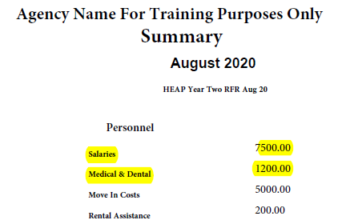
Grants & Contracts Requests for Reimbursements
Supporting Documentation for RFR’s
  To improve turnaround time for reimbursement payments provide the following:
    General Ledger: highlighted expenditures and a summary.
Notes:
Jess Torres

Slide 6
Grants & Contracts Program Monthly Reports
Program Monthly Reports Due every month by the 15th
  HEAP Year Two Instances of services are no longer needed. (Q5 in ZoomGrants)
  Run the Annual Performance Report as a cumulative to date.
    Upcoming Training Dates Poll will be emailed to collect the best time for everyone.
Notes:
Jess Torres

Slide 7
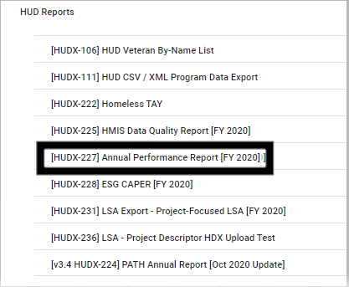
Homeless Management Information Systems
Reminders
  Data Quality
Clarity Report(s):
  [HUDX-227] Annual Performance Report
  https://www.rtfhsd.org/hmis/hmis-training-support/
Questions?

Slide 8
Questions?
Notes:
Please list any other topics your organization is interested in but is not listed in this survey.
1. Required case file documents
2. Populations unable to serve with these funds such as undocumented
3. Budget - when is a budget adjustment required - are we able to shift funds from one line item to another without an adjustment
4. *Potential funding opportunities (HEAP/NonHEAP) related. This could be new funding or available HEAP funding that needs reallocation.
5. Agency performance, next steps after contracts end

Slide 9
Resources
  Questions related to Grants & Contracts
  Heidi.Kone@rtfhsd.org
  Jessica.Torres@rtfhsd.org
  Questions related to HMIS
  Support@rtfhsd.org
  Also visit the RTFH Website:
Grant Recipients Link
RTFH HMIS Link

