Slide 1
CES Prioritization Tool
July 2021

Slide 2
What is Coordinated Entry?
What is it? A strategy that focuses on housing and service coordination to link those experiencing homelessness to the most appropriate housing resource to meet that individuals need.
What is its Purpose? To quickly identify homeless people, to prevent homelessness whenever possible, to appropriately assess the needs of consumers that request help, and to connect them to housing and services quickly.
What must it do? “The Coordinated Entry process must, to the maximum extent feasible, ensure that people with more severe needs and levels of vulnerability are prioritized for housing and homeless assistance before those with less severe service needs and lower levels of vulnerability.” HUD CE Notice CPD-17-01

Slide 3
What is the focus of San Diego’s CE System?
•Coordinated Entry for the San Diego COC focuses on three core concepts
•Housing First – Move individuals into housing FIRST and provide additional support to promote stabilization
•Harm Reduction – Reduce and minimize behaviors and consequences associated with drug and alcohol use.
•Trauma informed Care – Understand, recognize, and respond to the effects of all types of trauma.

Slide 4
What can be expected from CES?
When a permanent housing resource becomes available, CES will identify the next eligible households on the Community Queue based on CES community prioritization criteria and make a 1:1 referral for that opening based on:
● Appropriate / Best match: Client reported experience aligns with program eligibility
● Client choice: CES emphasizes client choice in all referrals. When no specific preference is indicated, clients are referred to the most restrictive or most abundant housing resource that they are eligible for. For example, a Veteran eligible for Veterans Affairs Supportive Housing (VASH) most likely would be matched to that program, rather than one utilizing CoC funding.

Slide 5
Coordinated Entry Workflow Overview
1
2
3
4
5
6
7
8
Your Service Provider Workflow
Enrollment into Coordinated Entry program
Complete a Current Living Situation Assessment
Complete a Vulnerability Assessment
Complete the CES Assessment
Referral to the Community Queue and Check In
Tracking CE Events through a program service
Exit from Coordinated Entry program
All clients that are entered into Coordinated Entry should already be enrolled in a program in HMIS.
3.10 Project Start Date should be the date that you started working with the client towards attaining housing.
4.12 Current Living Situation is required to be collected at every contact for Coordinated Entry programs.
This 4.19 Coordinated Entry Assessment informs prioritization from the Community Queue.
This 4.19 Coordinated Entry Assessment informs whether a client is on the Community Queue.
This 4.20 Coordinated Entry Event such as: (Access, Assessments, Prioritization, Referrals, and Placements) will result in a client being visible on the Community Queue.
Some 4.20 Coordinated Entry Events such as: (Access, Assessments, Prioritization, Referrals, and Placements) will need to be recorded through a program service.
The 3.11 Project Exit Date should be the date that the client is housed.

Slide 6
San Diego CoC Prioritization Policy
Upon completion of the CES workflow, households enrolled in SD CES are prioritized based on a number of vulnerability factors established by the San Diego CoC through the use of a community prioritization tool. This prioritization process helps to ensure that the region’s limited housing resources are reaching households with the greatest vulnerability in a timely and consistent manner.
San Diego CES prioritizes households by:
The longest history of experiencing homelessness and most needs.
The longest history of experiencing homelessness
The most needs, particularly mental illness or substance use disorder
All other: Non-Chronically homeless individuals, youth and families

Slide 7
Prioritization Tool in Action
The prioritization tool is used for identifying clients for case conferencing
It is also used as the assessment of the current BNL
To ensure that composite scores are reflective of data according to community standards

Slide 8
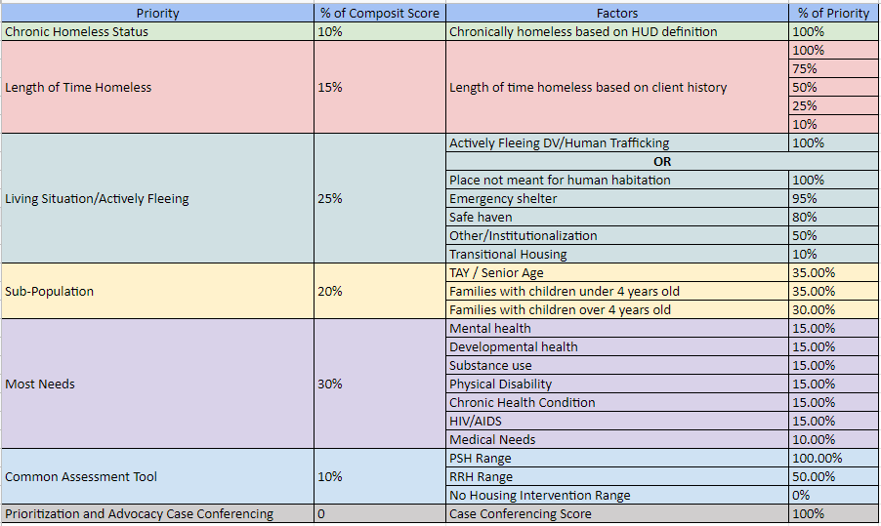
CES Prioritization Tool

Slide 9
What is Case Conferencing?
Case conferencing is a targeted discussion where homeless response providers including street outreach, CES, and housing providers, work together in meeting the needs of the most vulnerable households experiencing homelessness across the San Diego CoC geographic region. These households are identified by the CES team from the prioritized Community Queue (CQ).

Slide 10
Case Conferencing Structure
By Name Lists of the top 50-100 individuals for each specific sub population (Youth, Veterans, DV, Singles and Families) are pulled at least twice monthly to prepare for upcoming Case Conferencing
Top 25 of prioritized clients are selected from those specific BNL’s to be discussed
Case Conferencing schedule for specific populations can vary between as needed, bi weekly, or monthly
Case Conferencing, depending on flow, can last anywhere from 1-2 hours
Client Care Teams (who is currently assigned in HMIS or who has most recently worked with the client) are invited to case conferencing. This can include case managers, housing navigators, outreach, housing providers, etc.
Stay tuned as case conferencing is projected to re launch in the coming weeks.

Slide 11
What are the Goals of Case Conferencing?
1. To ensure coordination and assistance across providers for all those experiencing homelessness.
2. Client reviews that are housing focused and include intentional steps towards progress and evaluate barriers related to housing goals.
3. Strategize solutions as a community to identify client centered housing strategies that are equitable, rooted in housing first, and promote stability.
4. Become more streamlined as a continuum by reducing duplication of services for the clients we serve.

Slide 12
Questions?

