Slide 1


San Diego CES: Refresher Webinar
Pillars of CES
CES Workflow
Prioritization
Matching
Case Conferencing

Slide 2
San Diego CES: Pillars of CES

Slide 3

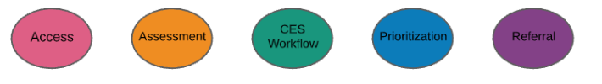

Core Components of CES

Slide 4
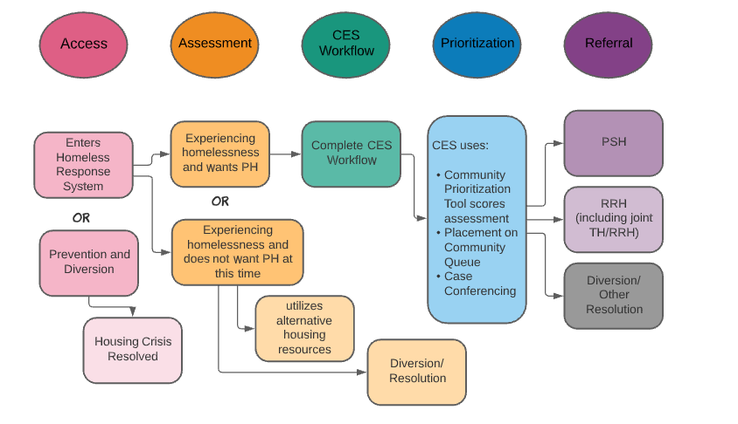
R CES Core Components: Explained

Slide 5
Specific CES Objectives in San Diego
A person – centric system of care
Commitment to comprehensive crisis response
Expand diversion and housing solutions based on need
Thoughtful approaches to harm reduction
Standard assessment tools
HMIS usage for the purpose of centralizing CES information
Regular evaluation

Slide 6


CES: What it is VS What it is not
A Guarantee of housing
A waitlist
A controller of housing availability
Determination of housing eligibility
Referral process for shelter or transitional housing
CES is the only pathway to housing
A Centralized system for identifying, assessing, and prioritizing vulnerable households
A match and referral process for connecting households to RRH and PSH resources

Slide 7
Pillars of CES quick guide video
CES Core Components
https://www.youtube.com/watch?v=-tHu9K2r9tw&list=PL5mWCtDUvVqYW0x53xHMlVt_LZ9MQYVNt&index=2

Slide 8
San Diego CES: CE Workflow

Slide 9
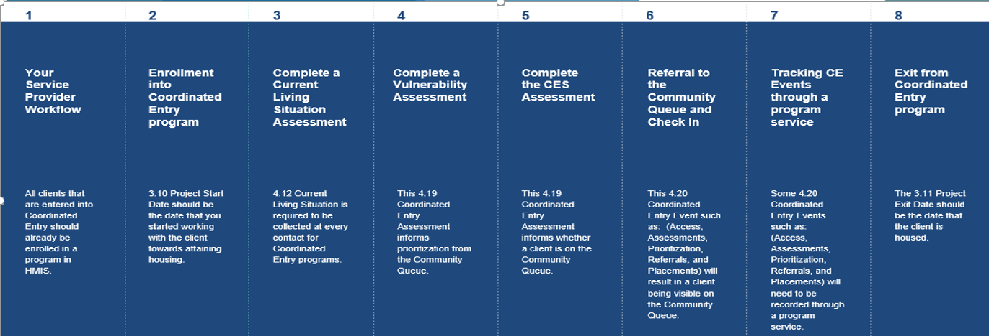
CES Workflow: Explained

Slide 10
CE Workflow Summarized
Client should be enrolled in your agencies project FIRST
Complete the Client Enrollment into CES
Complete a Current Living Situation Assessment
Complete the Appropriate CES Triage Tool
Refer the client to the Community Queue
Check in Client’s CQ Referral (this ensures client data and needs are up to date and remain visible to CES Matchers
Lastly, be sure to track CE events through program services as needed

Slide 11
San Diego CES: Workflow videos
CES Enrollment and CLS
https://www.youtube.com/watch?v=fBZNdfPehfQ&list=PL5mWCtDUvVqYW0x53xHMlVt_LZ9MQYVNt&index=7
Triage Tool and CQ Referral
https://www.youtube.com/watch?v=IUFeoiiYqbQ&list=PL5mWCtDUvVqYW0x53xHMlVt_LZ9MQYVNt&index=8
CE Check ins, events and exits
https://www.youtube.com/watch?v=dspaF3s1Y4Y&list=PL5mWCtDUvVqYW0x53xHMlVt_LZ9MQYVNt&index=9

Slide 12
San Diego CES: Prioritization

Slide 13
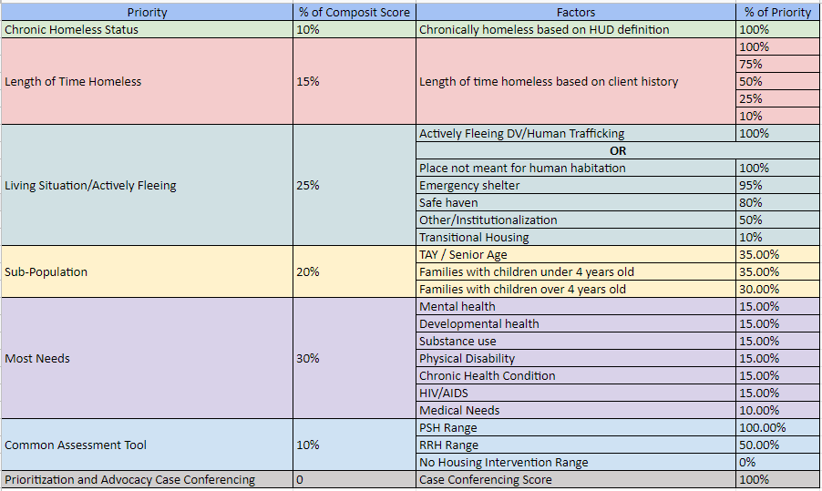
CES Prioritization: Explained

Slide 14
San Diego CES: Prioritization Video
Prioritization
https://www.youtube.com/watch?v=PEyMco5OOEM&list=PL5mWCtDUvVqYW0x53xHMlVt_LZ9MQYVNt&index=3

Slide 15
San Diego CES: Matching and Referrals

Slide 16

R Matching and Referrals: What to expect
01
Appropriate/ Best Match: Client reported experience aligns with program eligibility
02
Client Choice: CES matches reported experience to align with program eligibility. After the referral is sent, it is at the client’s discretion whether they accept or decline that resource.

Slide 17
R Matching and Referrals: What to expect
03
Referrals are filled upon request from providers. RTFH is not a repository for housing resources. If a provider has an opening, they send a referral request, this begins the CES selection process
04
Eligibility is King. Regardless of vulnerability or advocacy, RTFH cannot refer participants who do not meet general eligibility requirements

Slide 18
R Matching and Referrals: What to expect
05
Once a request is submitted. CES has 3 business days to fulfill the request.
06
Once a viable participant is selected for the resource, a match notification email is sent from rtfhsd.org to housing provider, CARE team, and other appropriate team members.

Slide 19
Referrals: Best Practices
Housing programs should use the housing first orientation
Minimal barrier to program entry
Accept referred individuals who meet basic program eligibility regardless of challenges
Programs may reject referrals if they are determined ineligible, pose safety concerns, or referred person is unable to be located
Contact attempt standards are 5 unique attempts within 5 business days of receipt of referral

Slide 20
Case Conferencing: What you should Know
Bi-weekly for Veteran Subpopulation can be used for difficult to fill units or new lease ups as well. Plans to expand to a variety of subpopulations in 2025.
Currently by invite only for CARE team, CE staff and other providers working with identified individuals
Intended to match vulnerable households to resources as quickly as possible
Attendance is crucial

Slide 21
Questions?
support@rtfhsd.org
www.rtfhsd.org

