Slide 1


COC Y FY 24
Office Hours
March 18, 2026
9:00 AM - 10:30 AM
Notes:
Housekeeping

Slide 2

Agenda
March 18, 2026 9:00 am - 10:30 am (PST)
Agenda Items |  | Presenter(s) | Duration
1 | Welcome | Susan Kim | 5 mins
2 | COC Y FY 24-FY 25 HUD NOFO Update | Kat Durant | 10 mins
3 | COC Y 23 Outcome Review & CoC Y 24 Q1 Review | Susan Kim | 10 mins
4 | ZoomGrants Report Review | Susan Kim | 10 mins
5 | HMIS Approach to Data Quality | Tyler Uhlig | 10 mins
6 | CES Updates | Jegnaw Zeggeye | 10 mins
7 | YHDP Survey | Susan Kim | 5 mins
8 | Q & A, Key Dates, Resources, Peer Discussion | Susan Kim | 15 mins
01
Notes:
Housekeeping Items: Names in the chat
Q&A at the end, but ask questions in the chat or raise hand.
Reason for the meeting; discussions at the end

Slide 3
COC Y FY24-FY25
HUD NOFO
Updates
Notes:
Include a chart showing amount YTD and clients served

Slide 4

HUD CoC NOFO FY24-FY25
Reinstated FY24-FY25 NOFO Release & Submission
On January 9, 2025, HUD released the FY24–FY25 CoC Competition and YHDP Renewal/Replacement NOFO
Submission deadline: February 9, 2026
RTFH submitted all required renewal materials and priority listings
Current Status
HUD has not yet begun issuing awards.
Renewals are still under review.
At this time renewals are still not guaranteed. There is no indication that HUD will just renew the applications.
HUD may evaluate: APR performance, grant spenddown, and timeliness
Congressional Direction to HUD
Allow 12-month non-competitive renewals if awards are delayed
Ensure projects are not penalized due to delays
Release the FY2026 NOFO by June 1, 2026

Slide 5
HUD CoC NOFO FY 2025
Litigation Impacting the FY25 CoC NOFO
A lawsuit, National Alliance to End Homelessness v. HUD, is challenging HUD’s handling of the FY25 Continuum of Care (CoC) NOFO.
The court issued a preliminary injunction, which temporarily paused HUD from moving forward with the FY25 NOFO competition.
This action restored the FY24-FY25 NOFO
HUD asked the court to lift the injunction so the FY25 NOFO could proceed.
On February 27, the judge denied that request, keeping the injunction in place.
HUD has appealed the decision and asked a higher court to allow the NOFO to proceed while the case is reviewed.

Slide 6
RTFH’s Plan for 2025 NOFO
If HUD wins the litigation to proceed with the 2025 NOFO, RTFH, as the designated grantee for YHDP Round 2, will prepare and submit the 2025 YHDP NOFO applications on behalf of the San Diego youth homelessness community. RTFH will not identify subrecipients during the application stage.
Host Homes and Youth Service Navigation Projects
  Will be submitted as renewals without changes to funding levels or outcomes.
  Are no longer held harmless and HUD may review past performance outcomes.
  Host Homes: $170,248 to serve 10 youths
  YSN: $1,300,363 to serve 602 youths
Joint TH-RRH and RRH Standalone Projects
  RTFH will submit one project application for a TH Project.
  Approximately $2,667,395
  Serve 39 youths

Slide 7
COC Y
FY 23 Outcomes
Notes:
Include a chart showing amount YTD and clients served

Slide 8
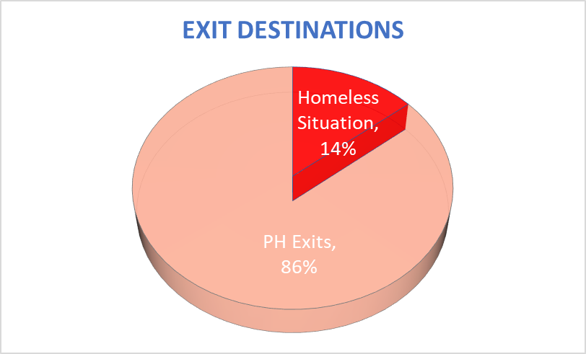
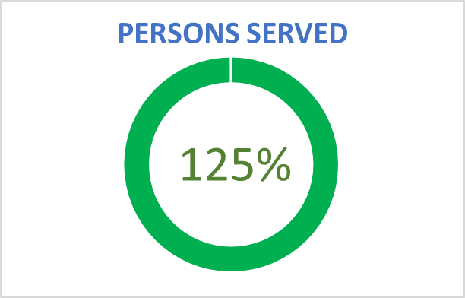
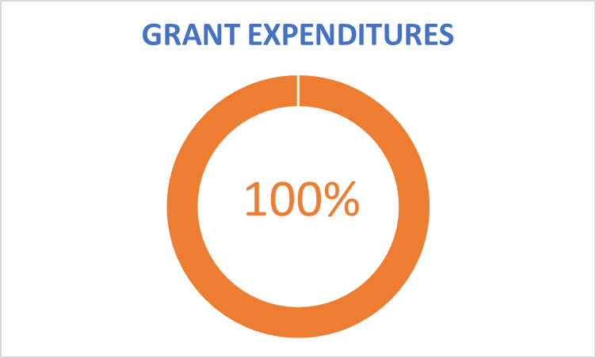
COC FY23 Rapid Re-Housing
Notes:
National Average for RRH PH%: 78%
SD is Above Average

Slide 9
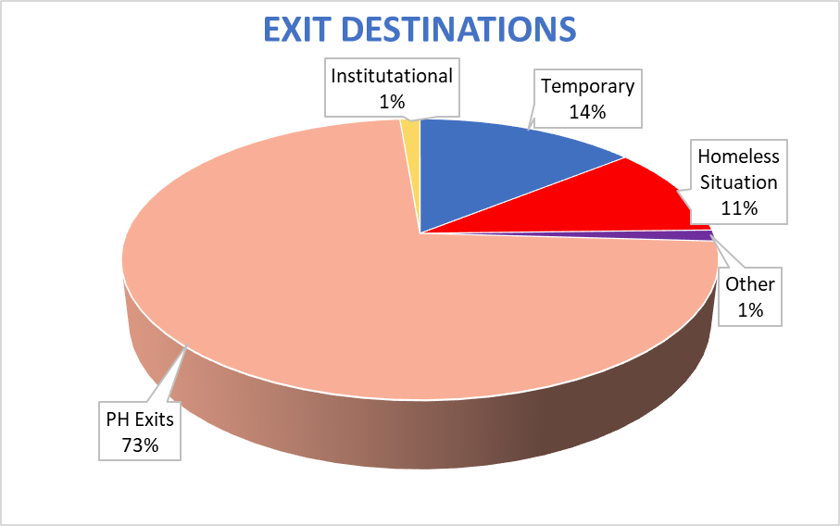
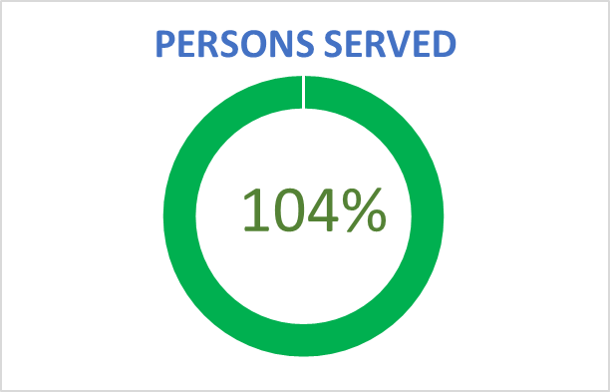
COC FY23 JOINT TH-RRH
Notes:
National Average:
JOINT TH: 73%
JOINT RRH: 72%
SD:
JOINT TH: 80%
JOINT RRH: 69%

Slide 10
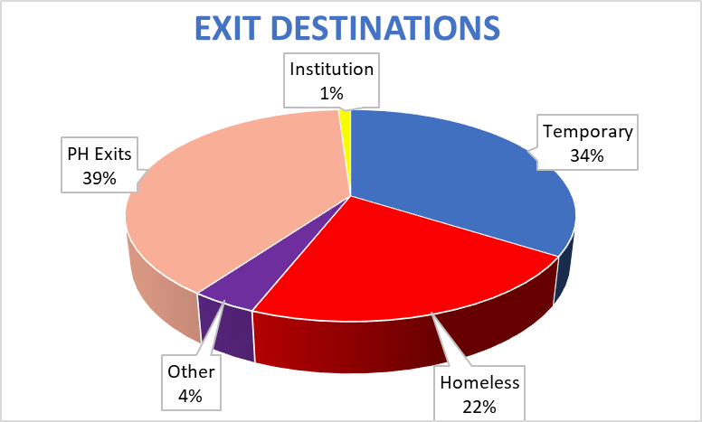
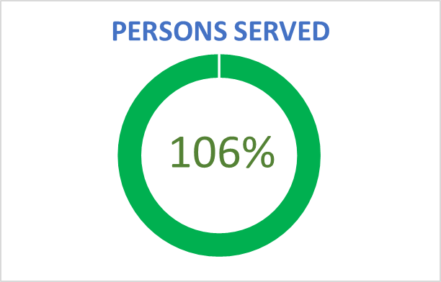
COC FY23 YSN
Notes:
National Average: 46%
SD: Below average

Slide 11
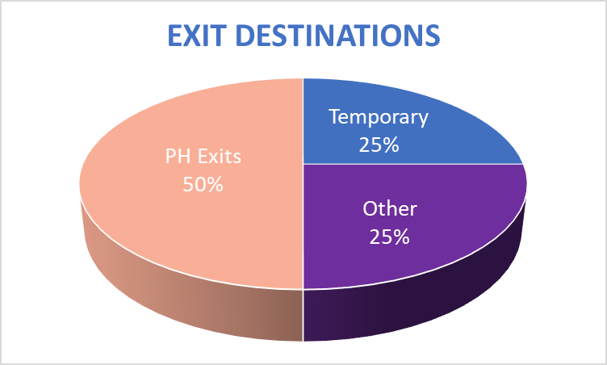
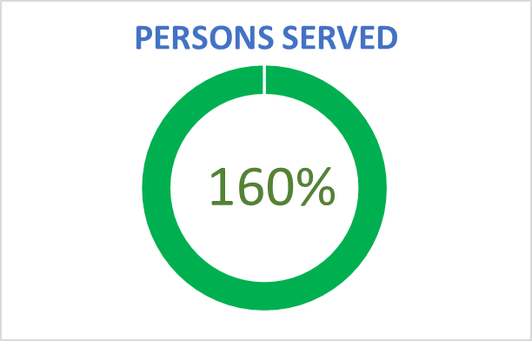
COC FY23 Host Homes
Notes:
National Average: 68%
SD: Below national average

Slide 12
CoC Y FY 24
Quarter 1 Outcomes
Notes:
Include a chart showing amount YTD and clients served

Slide 13
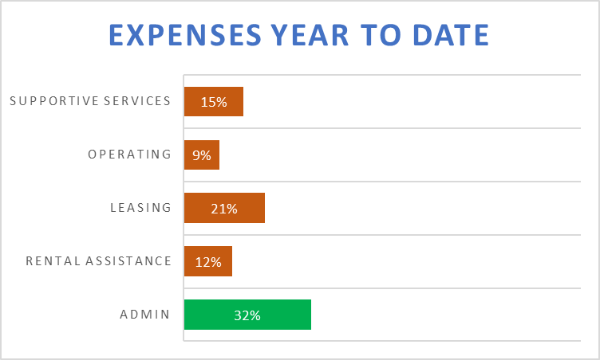
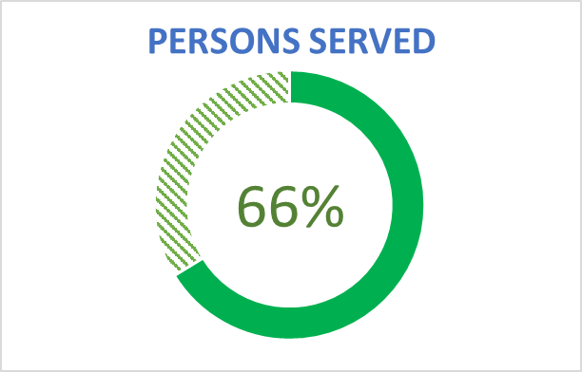
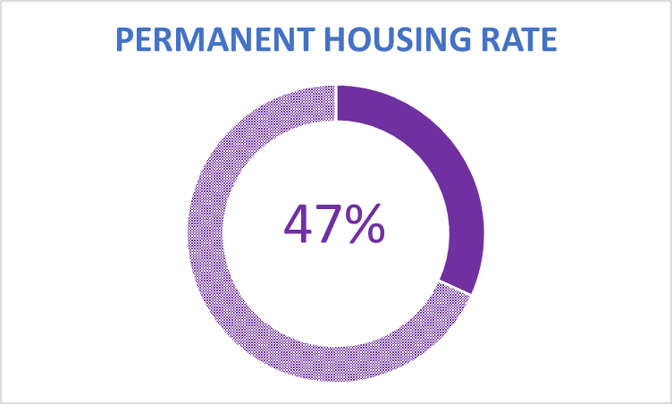
FY 24 Q1 Report: JOINT TH-RRH
December 1, 2025 - February 28, 2026
Notes:
JOINT Yearly Goal: 160
Actuals YTD: 106

Slide 14
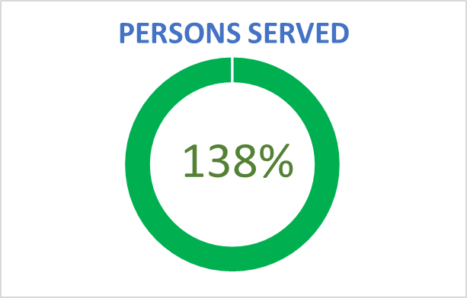
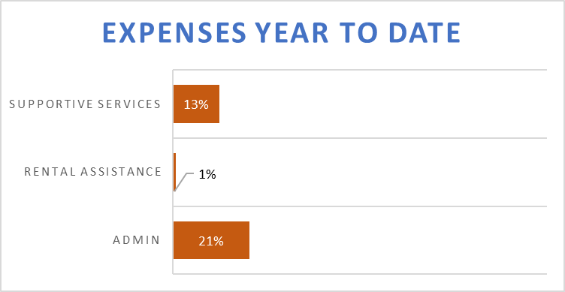
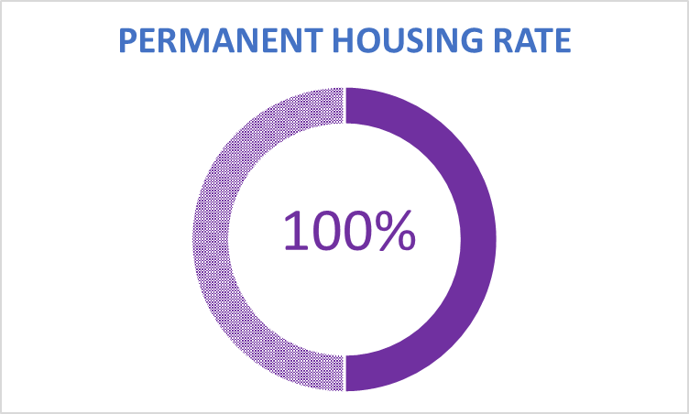
FY 24 Q1 Report: Rapid Re-Housing
December 1, 2025 - February 28, 2026
Notes:
JOINT Yearly Goal: 160
Actuals YTD: 106

Slide 15
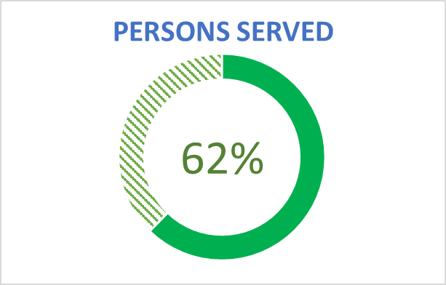

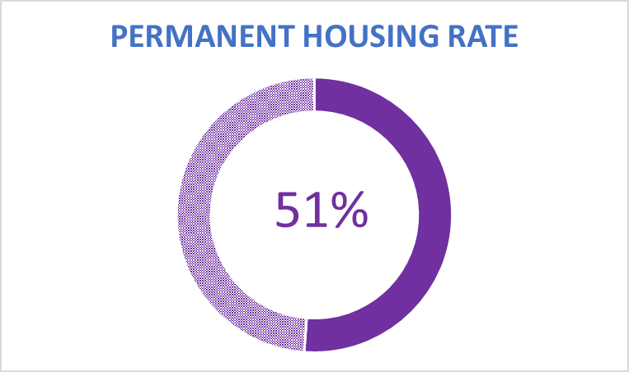
FY 24 Q1 Report: Youth Service Navigation
December 1, 2025 - February 28, 2026
Notes:
JOINT Yearly Goal: 160
Actuals YTD: 106

Slide 16
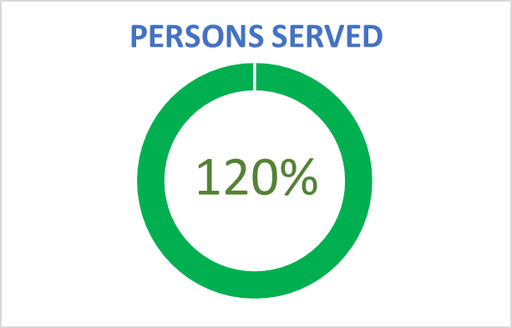

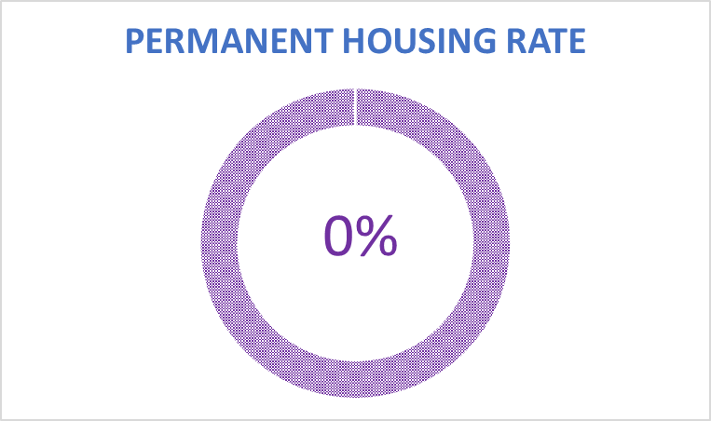
FY 24 Q1 Report: Host Homes
December 1, 2025 - February 28, 2026
Notes:
JOINT Yearly Goal: 160
Actuals YTD: 106

Slide 17
Housing Projects (JTR & RRH)
Joint TH-RRH and RRH Standalone Projects are:
Expected to house all their youths as soon as possible to ensure these projects meet expenditure and outcome goals.
Subrecipients will:
Work with Brilliant Corners (BC) to identify units and quickly house youth participants.
Have transition plans in place for youth beyond the grant year end (November 30th).
Provide Projection Sheets to G&C Team for monitoring as requested.

Slide 18
Reporting

Slide 19
ZoomGrants Reportings
Reports Due Quarterly:
HMIS to review Data and work with Reporting POC for Questions/Data Quality
Subrecipients will update the Table of Point of Contacts by March 31,2026
Quarter 1 | March 31, 2026
Quarter 2 | June 15, 2026
Quarter 3 | September 15, 2026
Quarter 4 | December 15, 2026
Notes:
POC

Slide 20
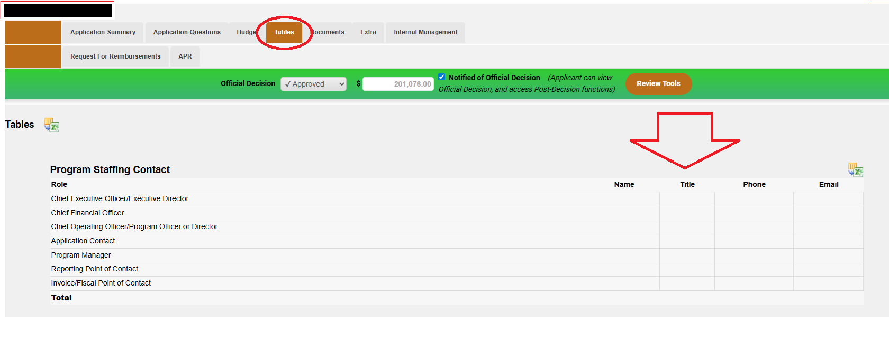
ZoomGrants Reportings
HMIS to review Data and work with Reporting POC for Questions/Data Quality
Subrecipients will update the Table of Point of Contacts (in ZG under Tables tab) by
COB, Tuesday, March 31, 2026.
Notes:
First Review is with HMIS, specifically APR Data
Second Review by G&C Team: Narratives, inconsistencies, etc.

Slide 21
ZoomGrants Narrative
Expectations
  Be specific with examples. (Remove PII)
  Include 1 success youth story with their journey to permanent housing.
  Describe services provided and actions taken to successfully transition to PH.
Outcomes
  Include quantifiable results
  Highlight accomplishments or lessons learned
Show Impact on:
  CCP/Systems Improvement
  Equity Efforts
Challenges
  Explain delays in spending and/or outcomes
  Identify risks or barriers
  HMIS data discrepancies
  Technical assistance needs
Notes:
Narratives should be specific with examples.
Qualitative Outcomes should include at least 1 success youth story with their journey to permanent housing. It should include services that were provided and what the youth did to successfully transition to PH.
Successes should include quantifiable outcomes and accomplishments or lessons learned. It may include how the project improved the CCP, homelessness system, address racial equity, etc.
Challenges and Barriers should include reasons why SR is behind on spending or outcomes. It may also include potential risks or how RTFH can support the project better.
Additional Comments should include any HMIS data discrepancies that are confirmed or any other information that you would like to provide. This can include technical assistance requests.

Slide 22
HMIS Approach to Data Quality

Slide 23
Why Focus on Data Quality?
CoC-Y is a necessary and effective means of serving youth experiencing homelessness
We need to continue to prove to funders via data that this is still the case
CoC-Y also informs and has impact on multiple system-wide reports also involved with funding
HUD System Performance Measures
California System Performance Measures (HHAP funding)
Sheltered Point in Time (Sheltered PIT)
Housing Inventory Count (HIC)

Slide 24
What We’re Looking At
Exit Destinations:
A Transitional Housing exit from a Joint TH-RRH program is considered a negative exit
  Transitional Housing appears on our Sheltered Point in Time Count as a homeless situation. Joint programs are housing programs
Data Not Collected/No Exit Interview Completed
  These should be minimized, especially in programs where ongoing case management or housing support are offered

Slide 25
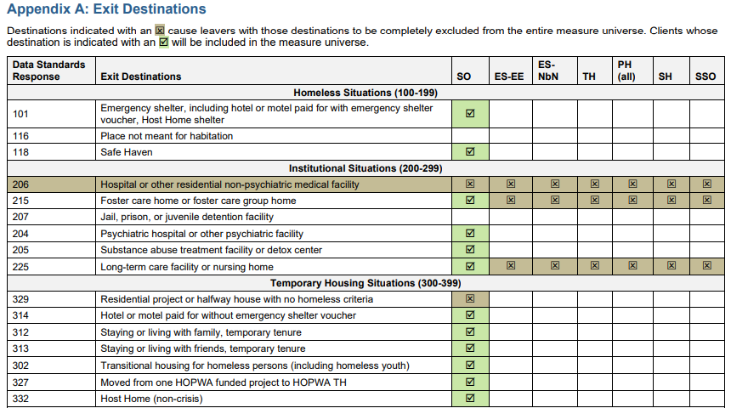

Slide 26
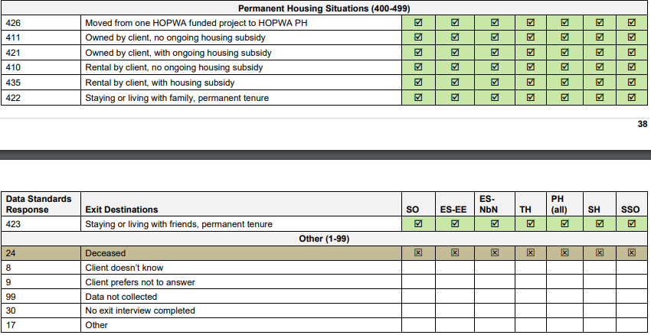

Slide 27
What We’re Looking At
Intake Data
Prior Living Data
  Particularly important for establishing eligibility
  Every missing prior living prompts explanation to HUD on APR, especially in housing programs
Chronic Data
  Times Homeless/Length Homeless can be difficult at times to collect
  Support and guidance is available via support team
  Data Standards have some guidance around what to do when some data points are difficult to capture

Slide 28
What We’re Looking At
Annual Assessments and Income
Income Data for all persons 18+ or Heads of Household
  Entry, Update, Annual, and Exit
  HUD now considering increase of income at exit
Annual Assessments
  Everyone staying 365+ days in a program needs an annual assessment each year
  Follows Head of Household (HoH) Anniversary date (project start date)
  We understand these can be difficult: support and guidance is available via support team
Missing an annual assessment counts as not having any of the data for many items in certain APR tables that view annuals.
This includes income data

Slide 29
What to Expect
More Regular Data Quality Check-ins
HMIS Team Members to be part of regular CoC-Y check-ins for Data Quality support
Emails from Support@rtfhsd.org for data cleaning
HMIS Staff will be available any time at support@rtfhsd.org for program staff needs related to data

Slide 30
Coordinated Entry System
(CES) Updates
Notes:
Include a chart showing amount YTD and clients served

Slide 31

CES Updates
Requirement:
HUD mandates that projects funded under CoC & Emergency Solutions Grant (ESG) programs use CES.
Goals of an Effective CES:
Quickly identify households experiencing homelessness
Resolve homelessness when possible through diversion
Assess the needs of households requesting help
Connect them to housing and services quickly.
Design & Intention
CES is to be an evolving process equipped to change and adapt to meet the needs of the community and the households experiencing housing crises.
Notes:
HMIS slide

Slide 32
CES Updates
Current San Diego CES Design:
Refers only to permanent housing resources, including Joint TH/RRH projects.
Referral Prioritization:
Based on the Community Prioritization Tool
Follows SD community standards:
  Chronic homelessness
  Current living situation
  Highest needs
  Sub-population considerations
Key Takeaway:
All Joint TH-RRH referrals go through CES & are prioritized according to these standards.
Notes:
HMIS slide

Slide 33
CES Waiver for Joint and Standalone RRH Projects
CES Waiver- when granted, provides an option to to meet grant requirements by housing youth outside of the regular CES process.
Providers must submit a formal request to RTFH and get approval to utilize the CES waiver.
Why CES waiver?
The current grant may change next year and the waiver provides flexibility to the program to meet the existing grant requirements during the transition.
Notes:
HMIS slide

Slide 34
YHDP Provider Survey
Notes:
Include a chart showing amount YTD and clients served

Slide 35

Feedback Survey
Subrecipient Capacity Self-Assessment Survey
Conducted by Equity in Action
Assessment of Grants Management, Systems & Centralized Rental Administration Readiness
Please complete the survey by 12 PM PST Friday, March 27th.
Notes:
Purpose of This Survey
This survey helps the RTFH understand your agency’s current grants management capacity, staffing, systems, and compliance familiarity. Your honest responses will directly shape the technical assistance, training, and centralized support we design for the region. There are no right or wrong answers.
Estimated to take 15-20 minutes to complete

Slide 36

01
Questions?
03
Notes:
Request that they submit their email addresses if they didn’t receive the invite for the office hours. (include this)

Slide 37
Resources & Discussion
Notes:
Include a chart showing amount YTD and clients served

Slide 38
Meeting Dates
Key Dates
Meeting Dates
Reports Due:
Next Quarterly Meeting:
Wednesday, June 24, 2026 9:00 AM - 10:30 AM
Q3 Meeting Date (Tentative):
Wednesday, August 26, 2026
9:00 AM - 10:30 AM
Q1: March 31, 2026
Q2: June 15, 2026
Q3: September 15, 2026
Q4: December 15, 2026
01
Notes:
Put

Slide 39
Resources
Grants & Contracts
HMIS
COC
01
Financial Questions
grants@rtfhsd.org
Data Questions
support@rtfhsd.org
COC Questions
cocsandiego@rtfhsd.org
RTFH Community Standards Click Here
All resources and documents can be found on the RTFH’s website: https://www.rtfhsd.org/funding/grant-recipients/
Notes:
Put

