Slide 1

Continuum of Care
Equal Access Basics and Implementation Tools
September 2022

Slide 2


HUDs Equal Access Rule
Notes:
The current Equal Access Rule was developed over time. Changes proposed in 2020 are NOT in effect, however 2016 and 2021 changes are.

Slide 3

What is the Equal Access Rule?
To ensure that HUD programs are open to all eligible individuals and families regardless of sexual orientation, gender identity, or marital status.
Individuals shall have access to housing according to their gender identity.
No requirements to “prove” gender identity.
Equal Access shall be provided in all HUD assisted programs.
Providers must update policies and procedures to reflect requirement.

Slide 4

Background: Equal Access Rule, 2016
Amended Definition
Barriers to Access
This rule amends HUD's definition of “gender identity” to more clearly reflect the difference between actual and perceived gender identity and eliminates the prohibition on inquiries related to sexual orientation or gender identity, so that service providers can ensure compliance with this rule.
HUD determined that the 2012 Equal Access Rule did not adequately address the significant barriers faced by transgender and gender nonconforming persons when accessing temporary, emergency shelters and other facilities with physical limitations or configurations that require and are permitted to have shared sleeping quarters or bathing facilities.
Specifically, HUD found that transgender and gender nonconforming persons continue to experience significant violence, harassment, and discrimination in attempting to access programs, benefits, services, and accommodations.

Slide 5

Definition: What does HUD define as a Family?
What this means is that any group of people that present together for assistance and identify themselves as a family, regardless of age or relationship or other factors, are considered to be a family and must be served together as such. Further, a recipient or subrecipient receiving funds under the CPD Programs cannot discriminate against a group of people presenting as a family based on the composition of the family (e.g., adults and children or just adults), the age of any member’s family, the disability status of any members of the family, marital status, actual or perceived sexual orientation, or gender identity.
https://www.hudexchange.info/faqs/programs/emergency-solutions-grants-esg-program/program-requirements/eligible-participants/how-is-the-definition-of-family-that-was-included/

Slide 6

Definition: What does HUD define as a Family, or a Household?
The definition of Household will also receive the “actual or perceived, sexual orientation, gender identity, or marital status” clarification:
  Household means all persons occupying a housing unit. The occupants may be a family, as defined in 24 CFR 5.403; two or more families living together; or any other group of related or unrelated persons who share living arrangements, regardless of actual or perceived, sexual orientation, gender identity, or marital status.

Slide 7

Definition: What does HUD define as a Family?
Family includes:
Family includes, but is not limited to, regardless of marital status, actual or perceived sexual orientation, or gender identity, any group of persons presenting for assistance together with or without children and irrespective of age, relationship, or whether or not a member of the household has a disability.
A child who is temporarily away from the home because of placement in foster care is considered a member of the family.
https://www.hudexchange.info/faqs/programs/emergency-solutions-grants-esg-program/program-requirements/eligible-participants/how-is-the-definition-of-family-that-was-included/

Slide 8

Background: Community Planning and Development Notice
CPD-15-02
On February 20, 2015, CPD issued guidance, entitled “Appropriate Placement for Transgender Persons in Single-Sex Emergency Shelters and Other Facilities” (CPD-15-02), which applied to CPD programs, including CoC.
This guidance clarified that HUD expected recipients and subrecipients under these programs to base placement decisions on the gender with which a person identifies—and not on another person's stereotype-based complaints—taking into consideration health and safety concerns and giving serious consideration to the transgender or gender nonconforming person's own personal health and safety concerns.

Slide 9

Equal Access: Policies and Procedures
Section 5.106(b) addresses the admissions, occupancy, and operating policies and procedures of recipients, subrecipients, owners, operators, managers, and providers covered by this rule.
Equal access ensures that, when consideration of sex is prohibited or not relevant, individuals will not be discriminated against based on actual or perceived gender identity, and where legitimate consideration of sex or gender is appropriate, such as in a facility providing temporary, short-term shelter that is not covered by the Fair Housing Act and which is legally permitted to operate as a single-sex facility, the individual’s own self-identified gender identity will govern.
64766 Federal Register / Vol. 81, No. 183 / Wednesday, September 21, 2016 / Rules and Regulations

Slide 10

HUDs Equal Access Rule
Specific strategies to implement Equal Access may include inclusive Policy Standards Anti-discrimination policies and procedures that:
Ensure placement and accommodation are made in accordance with an individual’s gender identity.
Ensure agency uses appropriate, inclusive language in communications, publications, trainings, personnel handbooks and other policy documents that affirms the agency’s commitment to serving all eligible clients in adherence with the Equal Access Rule.
Have an anti-harassment policy that includes transgender and non-gender conforming in the list of groups vulnerable to harassment and/or list of protected groups.

Slide 11

HUDs Equal Access Rule
Have a formal grievance process that is prompt, transparent and consistent in managing and resolving violations.
Include confidentiality practices that keep’s a client transgender status confidential, unless the client gives permission to share this information.
Allows for clients to request a private space for intake and data collection.
Outlines safety practices including respecting the client’s evaluation of their own safety practice with regard to proposed housing options and accommodating reasonable clients request regarding safety

Slide 12

Equal Access: Policies and Procedures
As preemptive steps, providers are strongly encouraged to post a notice of rights under this rule and under HUD’s 2012 Equal Access Rule on bulletin boards and in other public spaces where information is made available, to clearly establish expectations.

Slide 13

In order to ensure that individuals are aware of their rights to equal access, HUD proposes to require owners and operators of CPD-funded shelters and facilities to post on bulletin boards and in other public spaces where information is typically made available a notice entitled ‘‘Equal Access Regardless of Sexual Orientation, Gender Identity, or Marital Status for HUD’s Community Planning and Development Programs’’
https://www.hud.gov/sites/documents/LGBTFLYER.PDF

Slide 14

Equal Access: Policies and Procedures
Recordkeeping Requirements:
  This final rule redesignates the recordkeeping requirements from § 5.106(e) to 5.106(d) and states that providers must document and maintain, for a period of 5 years, records of compliance with the requirements of this rule regarding establishing or amending policies and procedures.

Slide 15


Equal Access Implementation Tools and Helpful Hints
Implementing the Equal Access Rules can be a challenging responsibility.
HUD, technical assistance providers, and national organizations have developed some tools to help support agencies in this process.
Today’s training introduces support tools:
Self–Assessment; Decision-Tree; and Simple Examples
Notes:
Implementing the Equal Access Rules and Fair Housing Regulations can be a challenging opportunity.
Fortunately, HUD engaged technical assistance and nationally recognized organizations to help support implementation.
Today we are introducing 3 tools for you: A Self-Assessment, a Decision-Making Tree, and some case examples

Slide 16
Equal Access AGENCY SELF - ASSESSMENT TOOL
This tool:
Helps homeless housing and service providers assess their compliance with the rules
Is intended for agency INTERNAL USE – not as a monitoring tool
Is Self-guided
Points out regulations and best practices
Has an index of definitions
Offers an easy-to follow chart guides agency administrators and staff through key aspects of:
  Agency Policy
  Harassment Guidelines
  Resolving Violations
  Ensuring Confidentiality
  Addressing Safety
Notes:
READ the 6 points, THEN DISPLAY a sample section of the tool..

Slide 17
Equal Access – Agency Assessment Tool
Item # | Attribute | Agency/Project has a Written Policy | Staff, Volunteers and Contractors are Trained to Comply with Written Policy | All Clients are Aware of the Agency/Project Policy
7 | If the Agency operates a family shelter, the Agency does not expel or decline a client of any gender if they are otherwise eligible for services. | Develop a policy statement and procedures to ensure that staff, volunteers and contractors do not expel or decline a client of any gender if they are otherwise eligible for services. | Train staff, volunteers and contractors on the agency's commitment to not expel or decline a client of any gender if they are otherwise eligible for services. | Publicize the agency's commitment to serve all families, regardless of gender, in project literature."
Harassment Policy
13 | Agency includes transgender and non-gender conforming in the list of groups vulnerable to harassment and/or list of protected groups. | In the list of protected groups within the agency's Policies and Procedures, add transgender and non-gender conforming. If your agency does not list protected groups, add a list and include this population. | Train staff, volunteers and contractors on the agency's inclusion of transgender and non-gender conforming in the list of groups vulnerable to harassment and/or list of protected groups. | Educate clients on the agency's inclusion of transgender and non-gender conforming in the list of groups vulnerable to harassment and/or list of protected groups.
Managing and Resolving Violations
20 | Agency has policy that if a client needs to be moved for harassment and safety concerns, the agency will have a preference to move the client with a bias. | Develop a policy statement and procedures that ensure if a client needs to be moved due to harassment and/or safety concerns, the agency will have a preference to move the client with a bias. | Train staff, volunteers and contractors on the agency's policy that if a client needs to be moved due harassment and/or safety concerns, the agency will have a preference to move the client with a bias. | Educate clients on the agency's policy that if a client needs to be moved due harassment and/or safety concerns, the agency will have a preference to move the client with a bias.
Notes:
Item #
Attribute
Agency/Project has a Written Policy
Staff, Volunteers and Contractors are Trained to Comply with Written Policy
All Clients are Aware of the Agency/Project Policy
7
If the Agency operates a family shelter, the Agency does not expel or decline a client of any gender if they are otherwise eligible for services.
Develop a policy statement and procedures to ensure that staff, volunteers and contractors do not expel or decline a client of any gender if they are otherwise eligible for services.
Train staff, volunteers and contractors on the agency's commitment to not expel or decline a client of any gender if they are otherwise eligible for services.
Publicize the agency's commitment to serve all families, regardless of gender, in project literature."
Harassment Policy
13
Agency includes transgender and non-gender conforming in the list of groups vulnerable to harassment and/or list of protected groups.
In the list of protected groups within the agency's Policies and Procedures, add transgender and non-gender conforming. If your agency does not list protected groups, add a list and include this population.
Train staff, volunteers and contractors on the agency's inclusion of transgender and non-gender conforming in the list of groups vulnerable to harassment and/or list of protected groups.
Educate clients on the agency's inclusion of transgender and non-gender conforming in the list of groups vulnerable to harassment and/or list of protected groups.
Managing and Resolving Violations
20
Agency has policy that if a client needs to be moved for harassment and safety concerns, the agency will have a preference to move the client with a bias.
Develop a policy statement and procedures that ensure if a client needs to be moved due to harassment and/or safety concerns, the agency will have a preference to move the client with a bias.
Train staff, volunteers and contractors on the agency's policy that if a client needs to be moved due harassment and/or safety concerns, the agency will have a preference to move the client with a bias.
Educate clients on the agency's policy that if a client needs to be moved due harassment and/or safety concerns, the agency will have a preference to move the client with a bias.

Slide 18
Equal Access – Decision Tree
This tool:
Gives concrete examples of behaviors that either encourage or discourage equal access
Has a easy-to read format
Walks through each phase of the process
Outreach & Engagement
Assessment
Referral
Program Enrollment
Assignment to housing unit / bed
Offering On-going services and supports
Notes:
THIS TOOL gives concrete examples of behaviors that either encourage or discourage equal access interactions.
Again, it offers concrete examples in a easy to follow format –
Lets take a look…

Slide 19











Supporting Equal Access Across the Full Spectrum of Services
Encouraging Discouraging
A staff person accepting the name and gender given by the potential client.
The staff person uses the pronoun as indicated by the client. This allows the person to feel more comfortable and continue in the outreach and engagement process.
If ID is required and the gender marker does not correspond to the client’s current gender ex- pression, the staff person uses the current gender expression as indicated by the client.
Outreach/Engagement
A staff person rejecting the client’s name or gender based on assumptions of the person’s name or sex-at-birth.
Using the incorrect pronoun after the client has given their preference.
Asking probing questions not necessary for engaging the individual. The individual may feel unsafe and choose to leave before outreach/engagement is complete.
If the person is feeling respected, they may give important information not included in the assessment that will assist in finding the right services for the individual. For example, based on the interaction, the staff may be able to recommend services to change the individuals ID along with risks and benefits.
A staff person accepts and uses the client’s preferred name and gender pro- noun regardless institutional documents or sex-assigned at birth. This allows the client to feel more comfortable and complete the assessment process.
Assessment
A staff person rejecting the client’s name or gender based on assumptions of the person’s name or sex-at-birth.
Using incorrect pronoun
after the client has given their preference.
Asking probing question regarding medications and medical procedures. If the individual feels harassed or violated by the staff or the process, the individual may abandon the assessment process and lose access to critical and potentially life saving services.
When referring a client to a single-sex or sex segregated project, the staff person offers to assist the client to ensure they are able to access services for which they are eligible. If the project rejects the client based on gender expression, the staff person reports the violation to the CoC while continuing to work with the client.
Making the connection to the referral project and only sharing information that the client has approved.
Listening to and respecting the client’s assessment of what feels safe to them when determining the referral options.
Referral
A staff person only makes re- ferrals to projects that the staff thinks will accept the client due to inappropriately perceived barriers.
A staff person does not follow-up with the receiving agency to make sure they are not discriminating against the client and turning them away.
A staff person provides information to the receiving project that discloses the client’s transgender status without the client’s consent.
Providing a confidential area to describe services that the client may want to access to ensure the client’s confidentiality.
The staff does not ask about the client’s sex assigned at birth during the intake process.
A staff person at a project that segregates services based on gender accepts the client whose gender expression does not
fit the stereotypical gender expression.
A staff person at a project that segregates services based on gender accepts the client who identifies with that gender.
Enrollment
A staff person turning away a potential client based on their gender expression.
A staff person treating a client in a way that violates the individual’s confidentiality around gender expression
A staff person does not respect the client’s assessment of their safety and tries to encourage them to go to a shelter that will make them “more comfortable” based on the staff person’s perceptions.
A staff person quickly resolves conflicts severe enough to warrant the expulsion of a harassing client.
Staff model appropriate respect and coach clients that express verbal and non-verbal disrespect.
Staff provide confidential space to allow clients to discuss issues related to harassment or other concerns connected to their current gender expression within the project.
Unit/Bed Assignment
A staff person ignores reasonable requests for accommodation in bed assignments based on a client’s health and safety concerns.
Staff move the more compliant client when conflict arises even if that client was the subject of harassment.
A staff person moves the gender non-conforming client when conflict arises based on the client’s gender identity.
The agency does not have bath- rooms and showers arranged to provide privacy.
A staff person recognizes the client’s right to access all services for which they are eligible.
Upon complaint, staff correct and engage clients’ misper- ception that gender expression creates a safety risk.
A staff person promotes
non-discrimination by ensuring all clients understand that verbal and physical bullying are not allowed.
Ongoing Service Provision
A staff person does not take a transgender client’s safety concerns seriously and fails to address them.
A staff person reassigns a trans- gender client’s bed based on another client’s complaint related solely to gender expression.
A staff person fails to intervene when a client is harassing someone based on their gender expression.
Notes:
The font is too small for you to see – so let’s choose just one piece as an example:
ACKNOWELDGE HUD CPD for the Decision- Making tool

Slide 20
Equal Access - Encouraging vs Discouraging Actions
ENCOURAGING
If identification is required and the gender designation doesn’t ‘match’ what the client states, the worker accepts and uses the identification expressed by the client.
DISCOURAGING
The worker states that the identification indicates a specific gender, and asks probing questions “to resolve the conflicting information” or informs the client that they will need to record the ‘correct’ information in the official case file.
Notes:
Acknowledge UD and NAEH Webinar – June 2018 for examples in today’s material

Slide 21
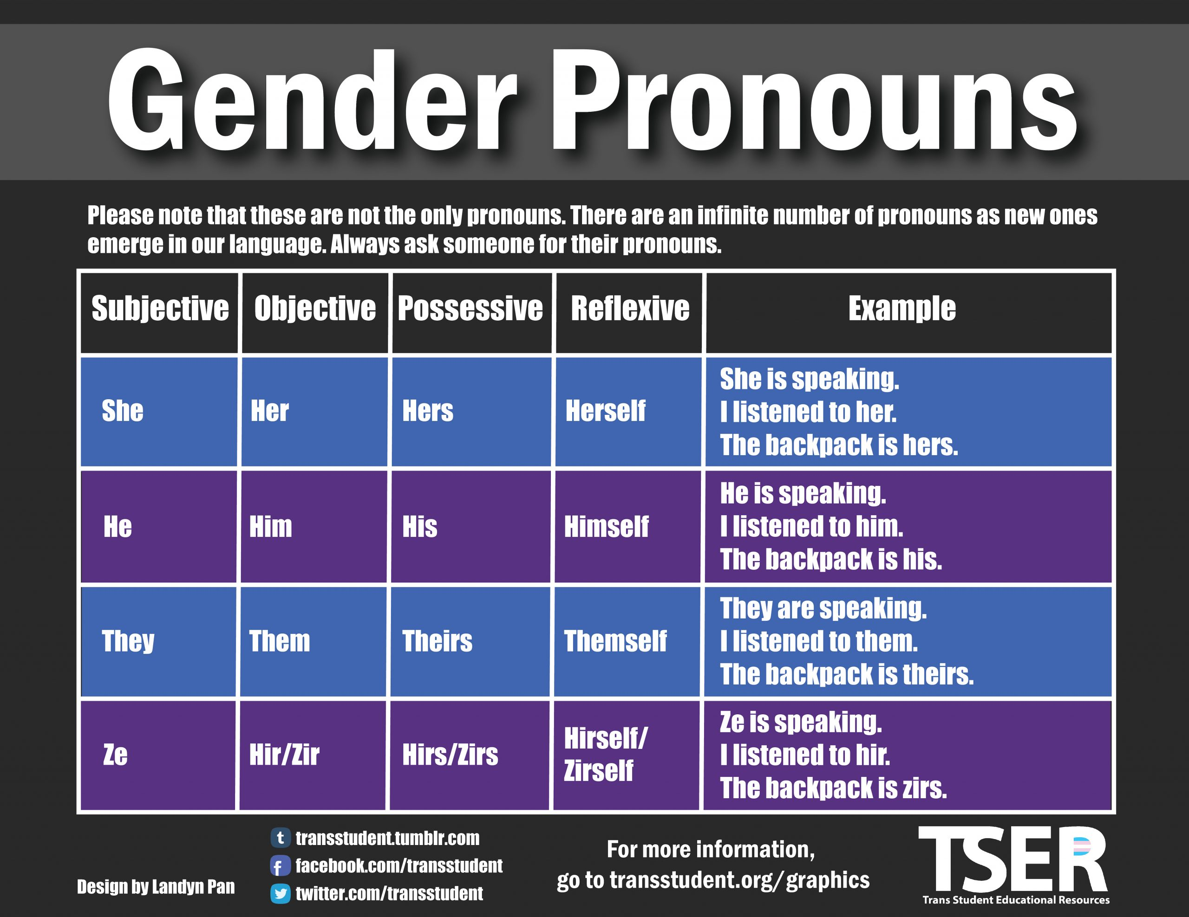
Quick Guide To Using Gender Pronouns – ASK!

Slide 22
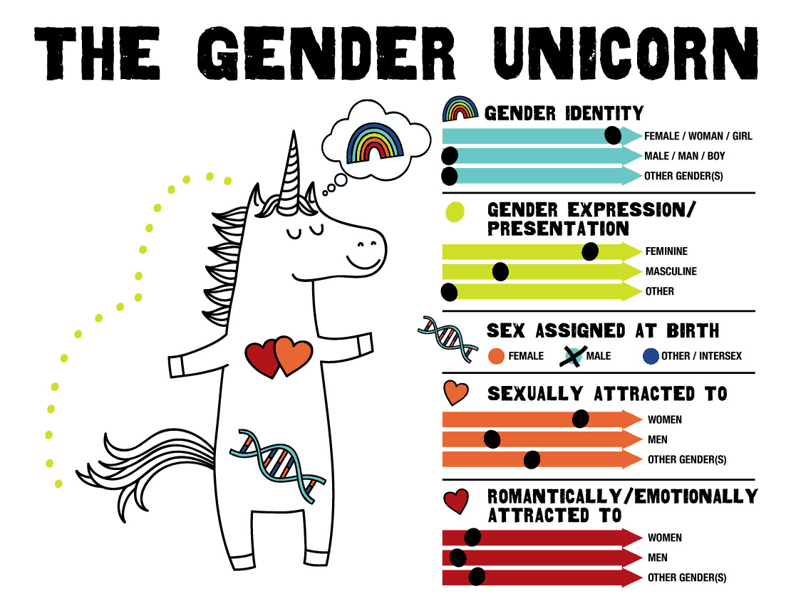
Equal Access - Simple Examples

Slide 23

Equal Access – Case Example – Question #1
If I operate a project using HUD funds that serves single women and children, do I need to serve men with children?
❑ Yes
❑ No
Notes:
HUD Says… YES --

Slide 24
CASE EXAMPLE - QUESTION #1
HUD SAID… YES!
HUD funded projects that serve families with minor children are not permitted to exclude families based on the gender of the head-of-household.
A household with a head-of-household who is male, and otherwise eligible for the service, must be provided access to the same services, opportunities, and staff to which all households enrolled in the project have access.
Projects may establish a requirement that they only serve households with minor children and exclude households comprised entirely of adults.
Knowledge Check

Slide 25
Equal Access - How Do We Handle Showers and Restrooms?
Access is based on self-declared gender identity
Increase privacy, when possible, by:
Installing temporary or permanent curtains
Installing locks, doors, or partitions to toilet stalls
Create staggered shower schedules for everyone to ensure access and to enhance privacy
Expand Access: Make single-use facilities all-gender, meaning anyone can use them

Slide 26
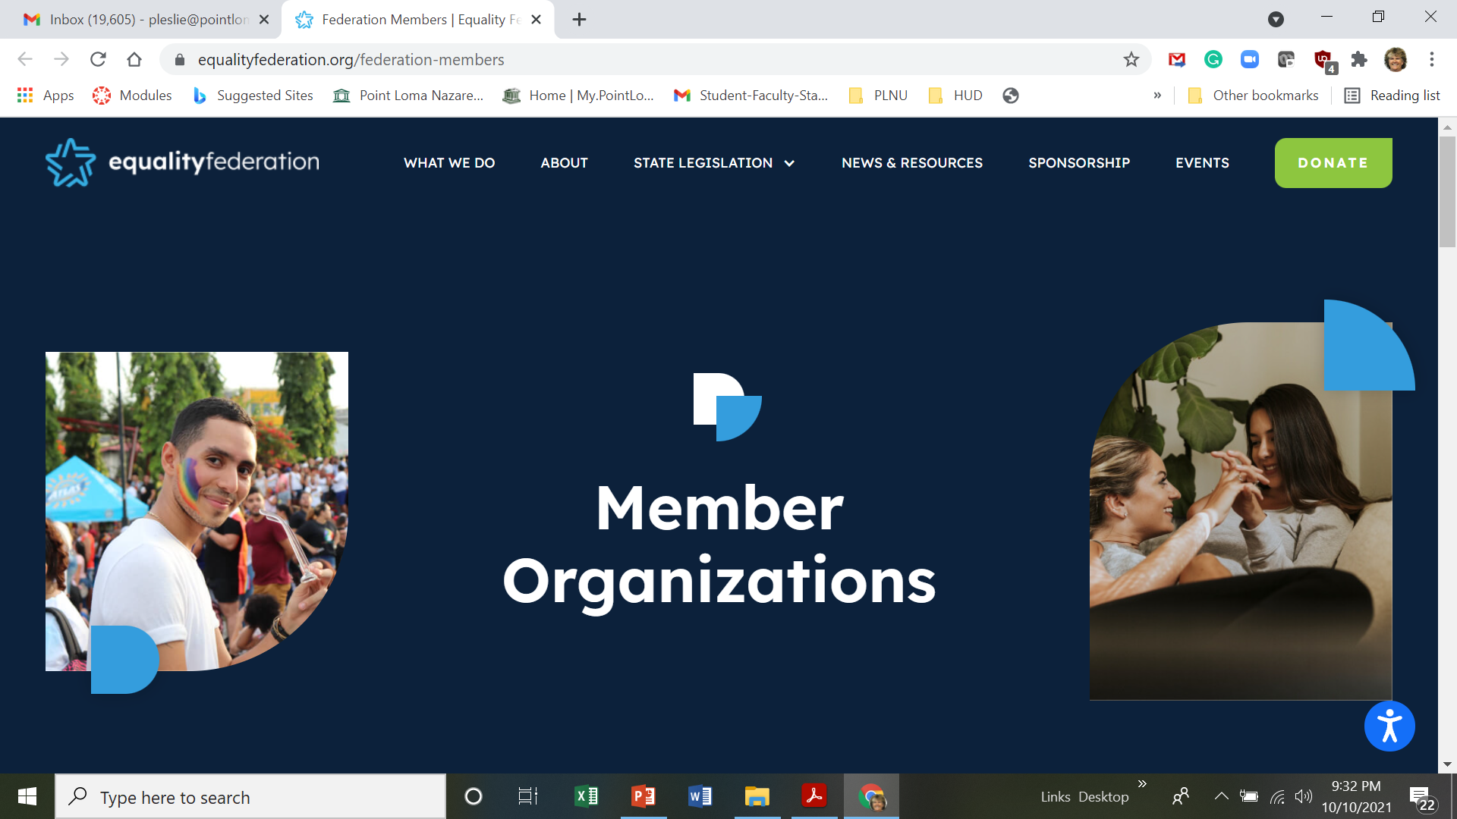
Equal Access Equality Federation – Statewide Advocacy Resources

Slide 27
Thank you!

